Slide 1
Chapter 5 Relations 关系
5.1 Relations and Their Properties 关系及其性质
5.2 n-ary Relations and Their Application n元关系及其应用
5.3 Representing Relations关系的表示
5.4 Closures of Relations 关系的闭包
5.5 Equivalence Relations 等价关系
5.6 Partial Orderings 偏序

Slide 2





5.1 Relations and Their Properties关系及其性质
【Definition】A binary relation R from a set A to a set B is a subset of A×B. 设A、B为任意两个集合，称笛卡儿积A×B的子集R为集合A到B的一个二元关系。若(x,y)∈R，则称x与y有关系R，记为 xRy
Note:
  A binary relation R is a set. 关系R是一个集合
  R ⊆ A×B 关系R的范围
〖Example 1〗
(1) Let A and B be sets,
(2)
(3) Let R be the set of real numbers,

Slide 3


5.1 Relations and Their Properties
Function As Relation 函数作为关系
A function f from a set A to a set B is a relation form A to B.
〖Example 2〗
Suppose that .
f: A→B, f(1)=f(3)=1,f(2)=f(4)=0
Conversely, if R is a relation from A to B, is it a function?
〖Example 3〗

Slide 4
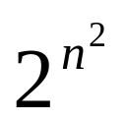
5.1 Relations and Their Properties
Relations On A Set 集合A上的关系
【Definition】A relation on the set A is a relation form A to A.
定义：集合A的关系是从A到A的关系
  Note: 特别，若关系定义中的A=B，则称R为集合A上的二元关系
  R ⊆ A×A
〖Example 4〗
Let
(2) Suppose that S is a set.
Question:
How many binary relations are there on a set A with n elements? n元素集合有多少个关系？

Slide 5
5.1 Relations and Their Properties
Representing Relations关系的表示
The methods of representing relation:
    list its all ordered pairs
    using a set build notation/specification by predicates
    2D table二维表格
    Connection matrix /zero-one matrix
    Directed graph/Digraph

Slide 6

5.1 Relations and Their Properties
〖Example 5〗
 | 2 | 3 | 4 | 5 | 6
2 | × |  | × |  | ×
3 |  | × |  |  | ×
4 |  |  | ×

Slide 7


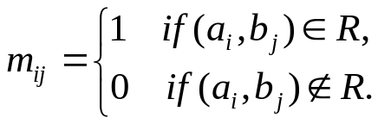
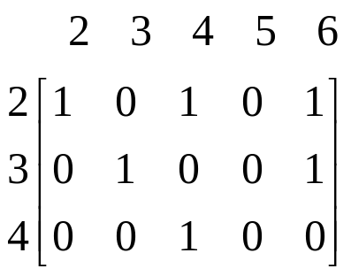
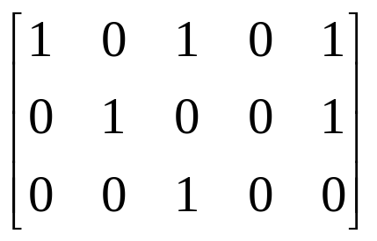
5.1 Relations and Their Properties
Connection Matrices 关系矩阵
【Definition】Let R be a relation from
An connection matrix for R is defined by
For example,

Slide 8
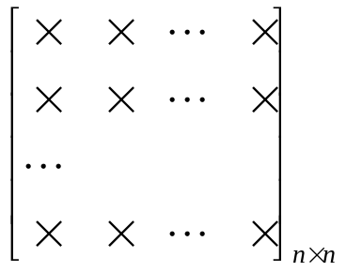
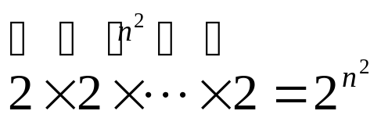
5.1 Relations and Their Properties
Question:
How many binary relations are there on a set A with n elements?
0,1
By the product rule,

Slide 9
5.1 Relations and Their Properties
Directed graph/Digraph 有向图
【Definition】A directed graph or a digraph, consists of a set V of vertices together with a set E of ordered pairs of elements of V called edges(or arcs)。 The vertices a,b is called the initial and terminal vertices of the edge (a,b).
定义：一个有向图由顶点（或结点）集V和边（或弧）集E组成，其中边集是V中元素的有序对的集合。顶点a叫做边（a,b)的始点，而顶点b叫做这条边的终点
2
For example,
2
3
4
3
5
4
6

Slide 10
5.1 Relations and Their Properties
〖Example 6〗A = {0, 1, 2,3}
0
1
3
2
R = {(0,0), (0,3), (2,0),(2,1),(2,3),(3,2)}.

Slide 11
5.1 Relations and Their Properties
Special Properties of Binary Relations 二元关系的特殊性质
    Reflexive 自反的
    Irreflexive 反自反的
    Symmetric 对称的
    Antisymmetric 反对称的
    Transitive 传递的

Slide 12
5.1 Relations and Their Properties
Special Properties of Binary Relations
    Reflexive自反的
    Irreflexive
    Symmetric
    Antisymmetric
    Transitive

Slide 13


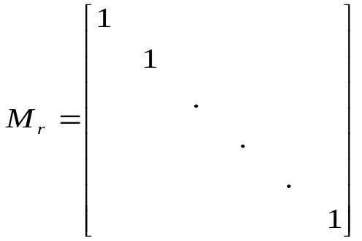
5.1 Relations and Their Properties
【Definition】A relation R on a set A is reflexive if
  若对每个x∈A，均有xRx,则称R为自反的
  Questions:
  (1) What do we know about matrices representing reflexive relations?
All the elements on the main diagonal of must
be 1s. 关系矩阵主对角线的所有元素都等于1

Slide 14
5.1 Relations and Their Properties
  (2) What do we know about digraphs representing reflexive relations?
  There is a loop at every vertex of the directed graph.对于有向图上的每个顶点都有个环

Slide 15
5.1 Relations and Their Properties
Special Properties of Binary Relations
    Reflexive
    Irreflexive 反自反的
    Symmetric
    Antisymmetric
    Transitive

Slide 16


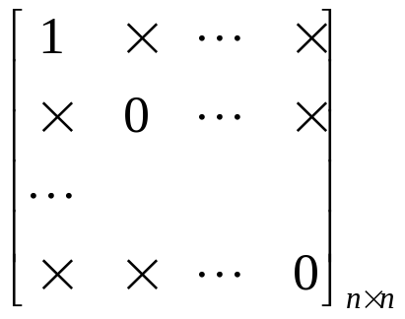
5.1 Relations and Their Properties
【Definition】A relation R on a set A is irreflexive if
  若对每个x∈A，均有x x,则称R为反自反的
  Questions:
  The connection matrix of a irreflexive relations?
  Digraph?
  Can a relation on a set be neither reflexive nor irreflexive? 有没有既不是自反的也不是反自反的关系？
  Yes.

Slide 17
5.1 Relations and Their Properties
Special Properties of Binary Relations
    Reflexive
    Irreflexive
    Symmetric 对称的
    Antisymmetric
    Transitive

Slide 18

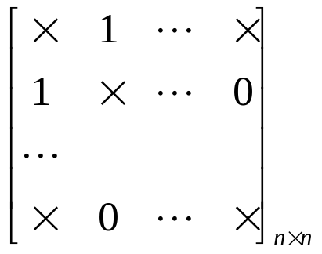
51 Relations and Their Properties
【Definition】A relation R on a set A is symmetric if
  对任意x,y∈A，若xRy,则yRx,就称R是对称的
  Questions:
  The connection matrix of a reflexive relations?
  Digraph?
  If there is an arc (x, y) there must be an arc (y, x).

Slide 19
5.1 Relations and Their Properties
Special Properties of Binary Relations
    Reflexive
    Irreflexive
    Symmetric
    Antisymmetric 反对称的
    Transitive

Slide 20
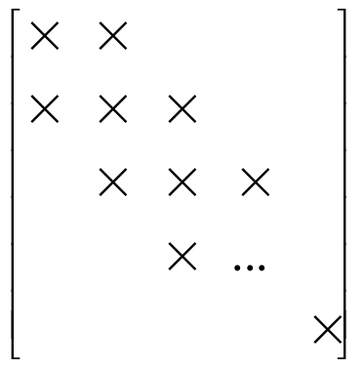
5.1 Relations and Their Properties
【Definition】A relation R on a set A is antisymmetric if
  对任意x,y∈A，若xRy且yRx，则x=y，就称R是反对称的
  Note:
  (1)
  (2)
1
0
0
1

Slide 21
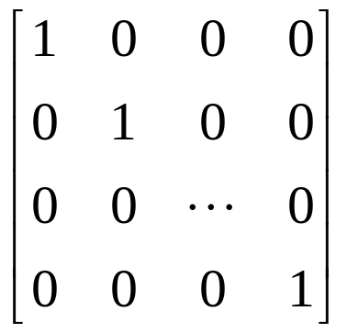
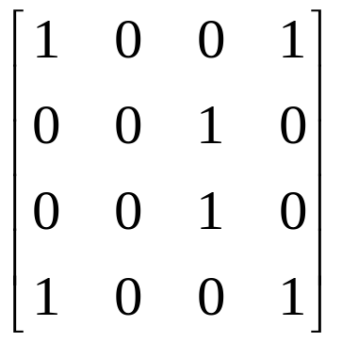
5.1 Relations and Their Properties
  (3) If there is an arc from x to y there cannot be one from y to x if x≠ y.如果x≠ y，弱有一条从x到y的弧，那么不可能存在从y到x的弧。
  (4) The symmetric and antisymmetric relations are not opposites. 对称的与反对称的关系不是对立的
  For example,

Slide 22
5.1 Relations and Their Properties
Special Properties of Binary Relations
    Reflexive
    Irreflexive
    Symmetric
    Antisymmetric
    Transitive 传递的

Slide 23
5.1 Relations and Their Properties
【Definition】A relation R on a set A is transitive if whenever
  定义：如果对于x,y,z ∈A （x,y) ∈R并且(y,z) ∈R则(x,z) ∈R,那么集合A上的关系R叫做传递的
  (1) If there is an arc from x to y and one from y to z then there must be one from x to z.

Slide 24
5.1 Relations and Their Properties
〖Example 7〗Determine whether the following relations are reflexive, irreflexive, symmetric, antisymmetric and/or transitive.
判断下列关系是否是 自反的，反自反的，对称的，反对称的，或是传递的？
  (1)
reflexive, symmetric, antisymmetric, transitive 自反的，对称的，反对称的，传递的

Slide 25
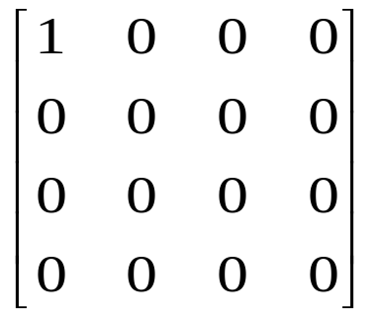
a
  (2)
b
d
c
not reflexive, symmetric, antisymmetric, transitive 不是自反的、对称的、反对称的、传递的

Slide 26

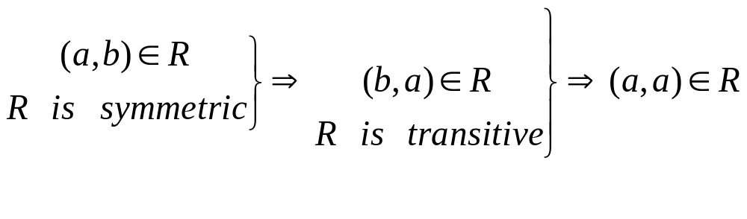
5.1 Relations and Their Properties
  (3)
reflexive, antisymmetric, transitive 自反的、反对称的、传递的
  Question:
  Symmetric, transitive ⇒ reflexive ?

Slide 27
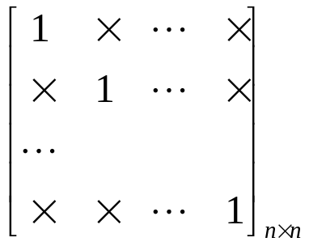
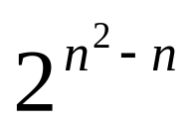
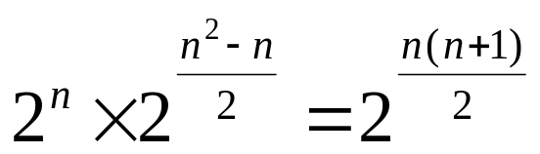
5.1 Relations and Their Properties
〖Example 8〗How many relations are there on a set with n
elements that are
(1) reflexive ? 自反的？
  (2) symmetric ? 对称的？
  (3) antisymmetric ? 反对称的？
Solution:
(1)
0,1
(2)

Slide 28
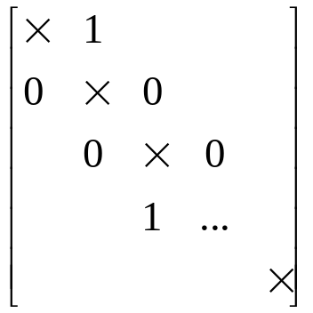
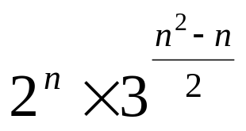
5.1 Relations and Their Properties
Solution:
(3)
Questions:
  transitive?传递的？

Slide 29
5.1 Relations and Their Properties
Combining Relations关系组合
Since relations form A to B are subsets of A×B, two relations form A to B can be combined in any way two sets can be combined.因为从A到B的关系是A×B的子集，可以按照两个集合组合的任何方式来组合两个从A到B的关系。
    Set operation集合运算
    Composition合成
    Inverse relation关系的逆

Slide 30
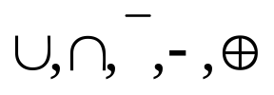




5.1 Relations and Their Properties
1
〖Example 9〗 Let is the set of integers,
what are the relations ?
Solution:
(1) Set operations
Boolean operations/logical operations 布尔运算/逻辑运算
The Boolean Sum
The Boolean product
The complement

Slide 31




5.1 Relations and Their Properties
The logical operations of matrices： 关系矩阵的逻辑运算
Let , the set
operations of two relations are defined by

Slide 32

5.1 Relations and Their Properties
2 Composition 关系的合成
The composite of R and S:
Question:
How to compute SoR?
    (1) Using the definition directly 用定义
    (2) Using the connection matrix 用关系矩阵

Slide 33




5.1 Relations and Their Properties
〖Example 10〗
Solution:
(1) Using the definition directly
Note:

Slide 34

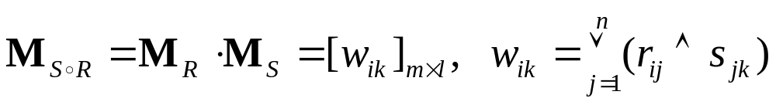
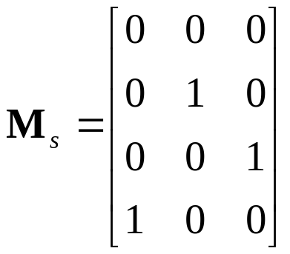
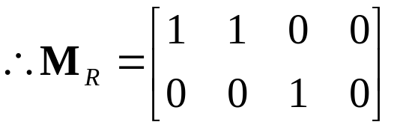
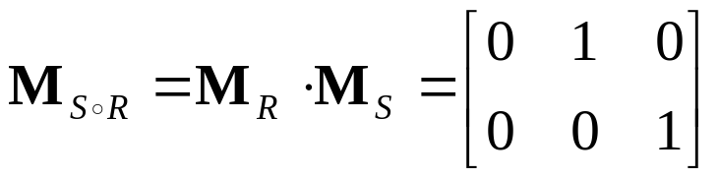

5.1 Relations and Their Properties
Solution:
(2) Using the connection matrix 使用关系矩阵

Slide 35




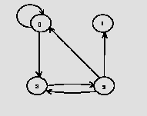
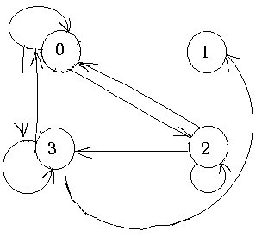
5.1 Relations and Their Properties
【Definition】Let R be a relation on the set A. The powers
,are defined inductively by
设R是集合A上的关系。幂 递归地定义为
〖Example 11〗Let A={0,1,2,3}. R is the relation on the set A.
R ={(0,0),(0,3),(2,3),(3,2),(2,1),(2,0)}. R²=?
Solution:
  Using the definition
    R²={(0,0),(0,3),(0,2),(2,2),(3,3),(2,3),(2,0),(3,1),(3,0)}
  Using the digraph

Slide 36

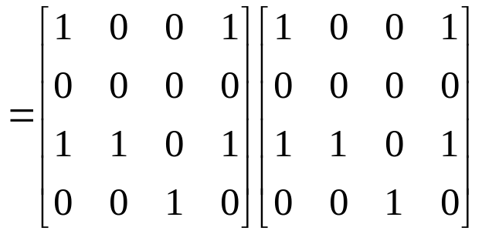
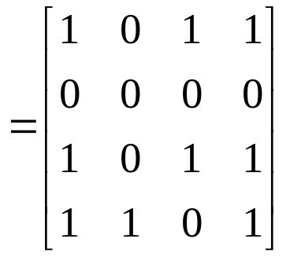
5.1 Relations and Their Properties
Using the matrix

Slide 37











5.1 Relations and Their Properties
【 Theorem 】 The relation R on a set A is transitive if and
only if 集合A上的关系R是传递的，当
且仅当对n=1，2，3…有
Proof:
(1)
⇒ R is transitive
(2) R is transitive ⇒
Inductive base
Inductive step
R is transitive

Slide 38






5.1 Relations and Their Properties
〖Example 12〗 Let R be a symmetric relation on the set A.
Show that R^{n} is symmetric for all positive integers n. 假设集
合A上的关系R是对称的，证明对于所有正整数n对于 都
是对称的
Proof:
Inductive base
n=1, R be a symmetric 对称的
Inductive step
R^{n} is symmetric ⇒ R^{n+1} is symmetric

Slide 39






5.1 Relations and Their Properties
3 Inverse relation 关系的逆
The inverse relation form B to A:
Question:
How to get ?
  Using the definition directly
  For example,
(2) Reverse all the arcs in the digraph representation of R
(3) Take the transpose M_{R} ^{T} of the connection matrix M_{R} of R.

Slide 40






5.1 Relations and Their Properties
4 The properties of relation operations 关系运算的性质
Suppose that R, S are the relations from A to B, T is the relation from B to C, P is the relation from C to D, then
(1)
Proof:

Slide 41







5.1 Relations and Their Properties
4 The properties of relation operations
Suppose that R, S are the relations from A to B, T is the relation from B to C, P is the relation from C to D, then
(1)
Proof:
(2)
(3)
(4)
(5)

Slide 42




5.1 Relations and Their Properties
4 The properties of relation operations
Suppose that R, S are the relations from A to B, T is the relation from B to C, P is the relation from C to D, then
(1)
(2)
(3)
(4)
(5)
(6)
(7)
(8)
(9)

Slide 43


5.2 n-ary Relations and Their Application n元关系及其应用
【Definition】 Let be sets. An n-ary Relation on
these sets is a subset of
The domains of relation
degree

Slide 44
Chapter 5 Relations
5.1 Relations and Their Properties
5.2 n-ary Relations and Their Application
5.3 Representing Relations
5.4 Closures of Relations 关系的闭包
5.5 Equivalence Relations
5.6 Partial Orderings

Slide 45
5.4 Closures of Relations 闭包关系
Reflexive Closure 自反闭包
Symmetric Closure 对称闭包
Transitive Closure 传递闭包
【Definition】The closure of a relation R with respect to
property P is the relation S with property P containing R
such that S is a subset of every relation with property P
containing R. R关于性质P的闭包是包含R的具有性质P的关系S ，并且S是每个包含R的具有性质P的关系的子集。
The smallest relation with property P containing R

Slide 46



5.4 Closures of Relations
Reflexive Closure自反闭包
【 Theorem 】 Let R be a relation on A. The reflexive closure
of R, denoted by r(R), is
The diagonal relation（对角关系） on A
Proof:
① containing R 包含R
② is a reflexive relation 是自反关系
③ is the smallest reflexive relation which contains R
Suppose that R’ is a reflexive relation containing R, then

Slide 47



5.4 Closures of Relations
【 Corollary 】 ⇔ R is a reflexive relation
R是自反关系.
Proof:
① The reflexive closure is a reflexive relation 自反闭包是自反关系
② Since R is a reflexive relation,

Slide 48

5.4 Closures of Relations
Question:
Given R, how to obtain its reflexive closure?
给定关系R，怎样获得自反闭包？
  Add to R all ordered pairs of the form (a,a) with a∈A, not already in R 在关系R中添加未在R中的形如(a,a) 的有序偶，a∈A
  Add loops to all vertices on the digraph representation of R.在表示关系R的图中的每个顶点加上环路
  Put 1’s on the diagonal of the connection matrix of R.将1添加到关系矩阵中的 主对角线上

Slide 49



5.4 Closures of Relations
〖Example 1〗 , What is r(R)?
  Solution:

Slide 50

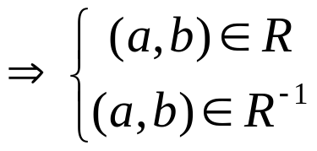




5.4 Closures of Relations
Symmetric Closure 对称闭包
【 Theorem 】 Let R be a relation on A. The symmetric closure
of R, denoted by s(R ), is
Proof:
① containing R
② is a symmetric relation 对称关系

Slide 51

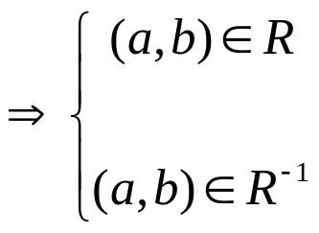
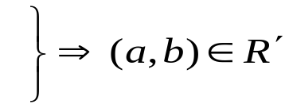








5.4 Closures of Relations
③ is the smallest symmetric relation which containing R
Suppose that R’ is a symmetric relation containing R, then

Slide 52

5.4 Closures of Relations
〖Example 2〗 What is s(R) of the following relation?
a
b
d
c
  Note:
  Add an edge from x to y whenever this edge is not already in directed graph but the edge from y to x is.
  Add all ordered pairs of the form (b,a) where (a,b) is in the relation, that are not already in R.

Slide 53




5.4 Closures of Relations
【Corollary】 ⇔ R is a symmetric relation .
R是对称关系
Proof:
① The symmetric closure is a symmetric relation
② Since R is a symmetric relation, it follows that

Slide 54



5.4 Closures of Relations
Transitive Closure传递闭包
Recall:
  The transitive closure of a relation R, t(R), is the smallest transitive relation containing R（R的传递闭包是包含R的最小的具有传递性的关系）.
  How can we construct t(R)?
    Can t(R) be produced by adding all the pairs of the form (a, c) where (a, b) and (b, c) are already in the relation?
〖Example 3〗 Suppose that be a relation on the set
    t(R)=?
  How to computer?

Slide 55
5.4 Closures of Relations
Terminology:术语
A path of length n （长为n的路径）in a digraph G :
A sequence of edges (x₀, x₁),(x₁, x₂),. . . ,(x_{n-1}, x_{n})
Notation: x₀, x₁, x₂,. . . , x_{n-1}, x_{n}.
Cycle or circuit （回路或圈）: If x₀ = x_{n}
For example,
a
b
d
c

Slide 56
5.4 Closures of Relations
The term path also applies to relation.
Why?
  Relation ↔ digraph
How?
  There is a path of length n from a to b in R
a, x₁, x₂,. . . , x_{n-1}, b such that (a, x₁)∈ R, (x₁, x₂)∈ R, …,( x_{n-1}, b)∈ R
如果存在一个元素序列
那么在R中存在一条从a到b的路径

Slide 57
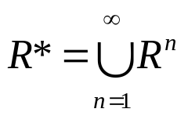
5.4 Closures of Relations
【Definition】 The connectivity relation（连通关系） denoted by R*, is the set of ordered pairs (a, b) such that there is a path (in R) of length at least one from a to b:
设R是集合A上的关系。连通性关系R*, 由对(a,b)构成，使得在R中从顶点a到b之间存在一条至少长为1的路径
〖Example 3〗 Let A = the set of people, R = {(x, y) | person x
is a parent of person y}. R* = ?

Slide 58


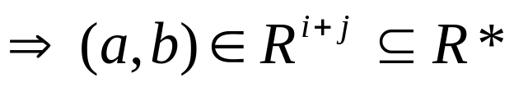
5.4 Closures of Relations
【 Theorem 】 t(R) = R*. 关系R的传递闭包等于连通性关系R*.
Proof:
① containing R
is a transitive relation 证明具有传递性
Suppose (a, c) and (c, b) are in R*. Show that (a, b) is in R*.
By the definition of R*,

Slide 59


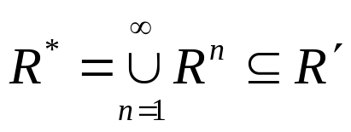
5.4 Closures of Relations
③ is the smallest transitive relation which contains R
Now suppose that R’ is any transitive relation which contains R.
We must show R’ contains R* to show R* is the smallest relation.
In fact, we need only consider paths of length n or less.

Slide 60
5.4 Closures of Relations
【 Theorem 】 If |A | = n, then any path of length > n must
contain a cycle. 对于有n个顶点的路径，如果存在一个
长度大于n的路径，那么该路径必存在环
Proof:
If we write down a list of more than n vertices representing a path in R, some vertex must appear at least twice in the list (by the Pigeon Hole Principle).

Slide 61




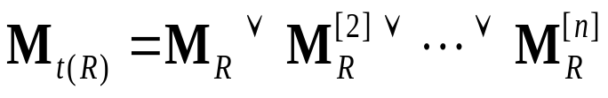
5.4 Closures of Relations
【Theorem】 If , R is a relation on A, then
【Corollary】 If , then
【Corollary】 Let be the zero-one matrix of the
relation R on a set with n elements. The zero-one matrix
of the transitive closure is 设 是n元素集合上的关系R
的0-1矩阵，那么传递闭包的0-1矩阵是

Slide 62
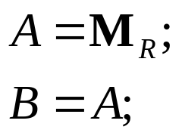
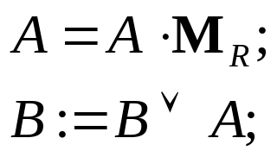
5.4 Closures of Relations
A Procedure for computing t(R)
for (i=2; i<=n; i++)
{
}
The complexity of algorithm:

Slide 63
Chapter 5 Relations
5.1 Relations and Their Properties
5.2 n-ary Relations and Their Application
5.3 Representing Relations
5.4 Closures of Relations
5.5 Equivalence Relations 等价关系
5.6 Partial Orderings

Slide 64
5.5 Equivalence Relations
Equivalence relations (等价关系)and equivalence classes （等价类）
【Definition】A relation R on a set A is an equivalence relation if R is（等价关系满足三个条件）
        Reflexive自反的
        Symmetric对称的
        transitive 传递的
For example,
(2) The similarity relation between two triangles
(3) The equivalent relation between two formulas in proposition logic

Slide 65


55 Equivalence Relations
Terminologies:术语
a and b are equivalent a和b是等价的
R is an equivalence relation, and (a , b)∈ R
the equivalence class of x
The set of all elements that are related to an element x of A
或者：设R为集合A上的等价关系，对每个x∈A，作集合
Notation:
a representative of the equivalence class 等价类的表示

Slide 66









5.5 Equivalence Relations
〖Example 1〗 Congruence Modulo 3 模3同余
Show that R is an equivalence relation. And find its equivalence
class. 证明它R是等价关系并且找出他的等价类
Solution:
reflexive 自反的
R is reflexive, since
② symmetric 对称的
③ transitive 传递的

Slide 67
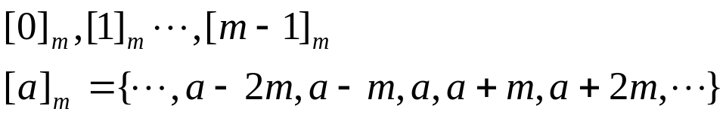
5.5 Equivalence Relations
[0]={…, -6, -3, 0, 3, 6, …}={ 3k | k ∈ Z }
[1]={…, -5, -2, 1, 4, 7, …}={ 3k+1 | k ∈ Z }
[2]={…, -4, -1, 2, 5, 8, …}={ 3k+2 | k ∈ Z }
Congruence Modulo m :
Congruence class Modulo m :

Slide 68


5.5 Equivalence Relations
〖Example 2〗 Suppose that A is a nonempty set, and f is a
function that has A as its domain. Let R be the relation on A
consisting of all ordered pairs (x,y) where f(x)=f(y).
  (1) Show that R is an equivalence relation.
  (2) What are the equivalence class of R.
Solution:
  (1)
reflexive
② symmetric
③ transitive
(2)

Slide 69






5.5 Equivalence Relations
Equivalence relations and partitions（划分）
【Definition】Let be a collection of subsets of A. Then the collection forms a partition of A if and only if
集合 构成
集合A的划分
当且仅当
Notation:
A₂
A₁
A₄
A₃
A₅

Slide 70
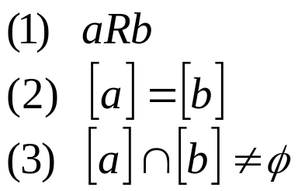




5.5 Equivalence Relations
【 Theorem 】 Let R be an equivalence relation on a set A.
The following statements are equivalent：设R是集合A上
的等价关系，下面
命题是等价的
Proof:
Show that (1) implies (2)

Slide 71






5.5 Equivalence Relations
Show that (2) implies (3)
R is reflexive ⇒ [a] is nonempty
Show that (3) implies (1)

Slide 72



5.5 Equivalence Relations
【 Theorem 】 Let R be an equivalence relation on a set A.
Then the equivalence classes of R form a partition of A.
Conversely, given a partition of the set A, there is
an equivalence relation R that has the sets ,
as its equivalence classes. 设R是集合A上的等价关系。那么R
的等价类构成S的划分。相反，给定集合S的划分
，存在着等价关系R，它以集合 作为它的等价类。
an equivalence relation on a set A ↔ a partition of A
the equivalence class of R :
Proof:
(1)对任意的a∈A，由R是等价关系有aRa，于是a∈[a]_{R}，即得任意等价类非空。显然有[a]_{R}⊆A。
(2)对任意的a、b∈A，有等价类[a]_{R}和[b]_{R}。
若aRb，则[a]_{R}＝[b]_{R}
若a与b不具有关系R，而[a]_{R}∩[b]_{R}≠∅，必存在x∈[a]_{R}∩[b]_{R}，于是aRx且bRx，从而有aRb，矛盾，所以[a]_{R}∩[b]_{R}＝∅。

Slide 73
5.5 Equivalence Relations
(3)对任意的a∈A有a∈[a]_{R}，而[a]_{R}⊆∪{[a]_{R}|a∈A}，所以a∈∪{[a]_{R}|a∈A}，即A⊆∪{[a]_{R}|a∈A}，又显然有∪{[a]_{R}|a∈A}⊆A，所以∪{[a]_{R}|a∈A}＝A。
定义R＝{<a，b>|a、b∈Ai，i＝1，2，…，n}，
对任意的a∈A，由π是A的划分知，必存在i使得a∈A_{i}，于是aRa，所以R是自反的。
对任意的a、b∈A，若aRb，则存在i使得a、b∈A_{i}，于是b、a∈A_{i}，所以bRa，因而R是对称的。

Slide 74
对任意的a、b、c∈A，若aRb且bRc，则存在i、j使得a、b∈A_{i}及b、c∈A_{j}。因为i≠j时A_{i}∩A_{j}＝∅，故必有i＝j，即有a、c∈A_{i}，于是aRc，所以R是传递的。
总之R是A上的等价关系。
下证对任意a∈A_{i}有[a]_{R}＝A_{i}。
对任意的x∈A_{i}，由R的定义有aRx，有x∈[a]_{R}，于是A_{i}⊆[a]_{R}。反之，对任意的y∈[a]_{R}，则aRy，由R的定义得y∈A_{i}，于是[a]_{R}⊆A_{i}。所以[a]_{R}＝A_{i}。
因为任一划分块都是一个等价类，所以π＝A/R。

Slide 75
5.5 Equivalence Relations
〖Example 3〗 Find the partition of the set A from R.
Solution:
4
[0]={0}
[1]={1,2,3}
[4]={4,5}
pr(A)={ [0], [1], [4]}
1
0
3
2
5

Slide 76

5.5 Equivalence Relations
Question:
Congruence Modulo m 模 m的同余类
Question:
|A|=3. How many different equivalence relations on the set A are there?
Solution:
an equivalence relation on a set A ↔ a partition of A

Slide 77






5.5 Equivalence Relations
The operations of equivalence relations
【 Theorem 】 If are equivalence relations on A, then
is equivalence relations on A.如果 是A上的等价
关系，那么 也是A上的等价关系
Proof:
It suffices to show that the intersection of
  reflexive relations is reflexive,自反证明
  symmetric relations is symmetric,
and
  transitive relations is transitive.

Slide 78




5.5 Equivalence Relations
The operations of equivalence relations
【 Theorem 】 If are equivalence relations on A, then
is equivalence relations on A.
Proof:
It suffices to show that the intersection of
  reflexive relations is reflexive,
  symmetric relations is symmetric,对称证明
and
  transitive relations is transitive.

Slide 79




5.5 Equivalence Relations
The operations of equivalence relations
【 Theorem 】 If are equivalence relations on A, then
is equivalence relations on A.
Proof:
It suffices to show that the intersection of
  reflexive relations is reflexive,
  symmetric relations is symmetric,
and
  transitive relations is transitive. 传递证明

Slide 80






5.5 Equivalence Relations
【 Theorem 】 If are equivalence relations on A, then
is reflexive and symmetric relation on A. 如果 是A
上的等价关系，那么 在A上具有自反的和对称的关系
Proof:
(1) reflexive 证明自反的
(2) Symmetric证明对称的
Question: transitive?

Slide 81
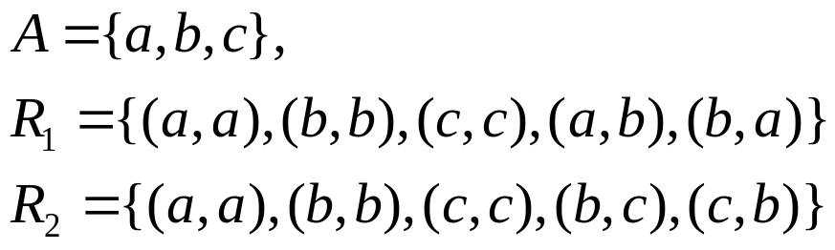

5.5 Equivalence Relations
〖Example 4〗
Is a transitive relation ?
Solution:

Slide 82


5.5 Equivalence Relations
【 Theorem 】 If are equivalence relations on A, then
is an equivalence relation on A. 如果 是A的等价
关系，那么 是A上的等价关系
Proof:
(1) reflexive自反的
(2) symmetric对称的
(3) transitive传递的

Slide 83
Chapter 5 Relations
5.1 Relations and Their Properties
5.2 n-ary Relations and Their Application
5.3 Representing Relations
5.4 Closures of Relations
5.5 Equivalence Relations
5.6 Partial Orderings 偏序关系

Slide 84
5.6 Partial Orderings偏序
Partial Orderings
【Definition】Let R be a relation on S. Then R is a partial ordering or partial order if R is
        Reflexive自反的
        antisymmetric 反对称的
        transitive 传递的
Notation: (S, R) ---- partially ordered set or a poset 偏序集
〖Example 1〗

Slide 85




5.6 Partial Orderings
Notation:
【Definition】comparable/ incomparable 可比/不可比
The elements a and b of a poset are called comparable if
either . When a and b are elements of S such
that neither , a and b are called incomparable.
偏序集（S，≦）的元素a和b叫做可比的。如果a≦b或b≦a。当a和b是S的元素并且既没有a≦b，也没有b≦a，则称a和b是不可比的
For example,

Slide 86




5.6 Partial Orderings
【Definition】If is a poset and every two elements of S are comparable, S is called a totally ordered（全序） or linearly ordered set, ≤ is called a total order or linear order. In this case is called a chain（链）.
如果 是偏序集，且S的每对元素都是可比的，则S叫作全序集或线序集，且≤叫做全序或线序。一个全序也叫做链。
〖Example 2〗
(1) is a poset. In this case either . Hence, ≤ is a total order and is a chain.
(2) is a poset, not a totally ordered set.
(3) is a poset, not a totally ordered set.

Slide 87






5.6 Partial Orderings
Lexicographic Order （字典顺序）
The lexicographic order is a special case of an ordering of strings on a set constructed from a partial ordering on the set.
字典顺序是从一个集合上的偏序构造一个集合上的串的序的特殊的情况
Given two posets and , we construct an induced
partial order R on : if
or
This definition of lexicographic order extends naturally to multiple Cartesian products of partially ordered sets.

Slide 88


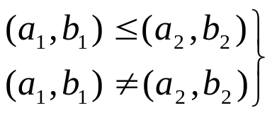
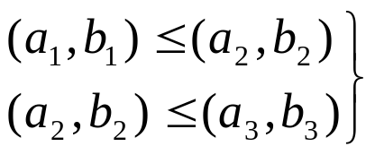

5.6 Partial Orderings
A lexicographic ordering is a partial ordering defined on a
Cartesian product of two posets.
Proof:
reflexive
② antisymmetric
③ transitive

Slide 89






5.6 Partial Orderings
〖Example 3〗Let . Then
(2, 4) < (2, 8) since
(2, 4) is not related under R to (2, 6) since
but 4 does not divide 6.
(2, 4) < (4, 5) since
〖Example 4〗 Using the same definitions of as above,
( 2, 3, 4, 5) < ( 2, 3, 8, 2) since and 4 divides 8.
(2, 3, 4, 5) is not related to (3, 6, 8, 10) since 2 does not divide 3.

Slide 90


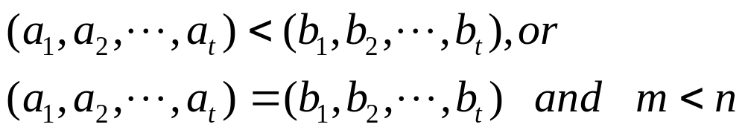

5.6 Partial Orderings
lexicographic order of string
The string is less then if and only if
Where
For example,
Find the lexicographic ordering of the following strings.
discrete discredit discreet discreteness discretion
discredit < discreet < discrete < discreteness < discretion

Slide 91
5.6 Partial Orderings
Hasse Diagrams 哈塞图
Hasse Diagrams
---- A method used to represent a partial ordering
（用来描述偏序关系）
To construct a Hasse diagram（哈塞图的构造）:
1) Construct a digraph representation of the poset (A, R) so that all arcs point up (except the loops).构造代表偏序关系的有向图
2) Eliminate all loops去掉所有环
3) Eliminate all arcs that are redundant because of transitivity由于传递性，除去冗余的边
Eliminate the arrows at the ends of arcs since everything points up. 移走所有有向边上的箭头。

Slide 92
5.6 Partial Orderings
〖Example 5〗
8
4
6
9
2
3
5
7
1

Slide 93
5.6 Partial Orderings
〖Example 5〗
8
4
6
9
2
3
5
7
1

Slide 94
5.6 Partial Orderings
〖Example 5〗
8
4
6
9
2
3
5
7
1

Slide 95
5.6 Partial Orderings
〖Example 5〗
8
4
6
9
2
3
5
7
1

Slide 96
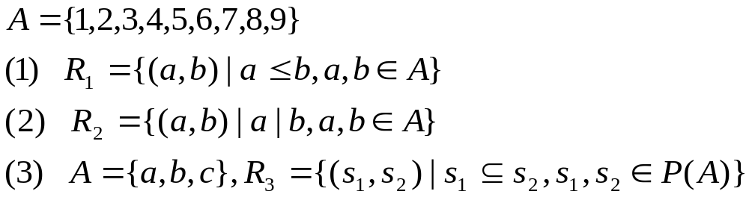
5.6 Partial Orderings
〖Example 6〗
9
8
7
6
5
4
3
2
1

Slide 97
5.6 Partial Orderings
〖Example 6〗
9
8
8
7
6
4
6
9
5
4
2
3
5
7
3
2
1
1

Slide 98
5.6 Partial Orderings
〖Example 6〗
9
8
{a,b,c}
8
7
6
4
6
9
{a,b}
{a,c}
{b,c}
5
4
2
3
5
7
3
{a}
{b}
{c}
2
1
1
φ

Slide 99



5.6 Partial Orderings
chain and antichain
【Definition】 is a poset. ，if is a
totally ordered set，the B is called a chain of .
The length of chain：|B|, B is a definite set，
，if
the B is called a antichain of .

Slide 100



5.6 Partial Orderings
Maximal and Minimal Elements 极大元和极小元
【Definition】Let be a poset. , then a is a
maximal element if there does not exist an element b in A such
that .a在偏序集 中是极大的，当不存在b∈A使得a＜b。
Similarly for a minimal element.
For example,

Slide 101
5.6 Partial Orderings
9
8
{a,b,c}
8
7
Note:
Maximal and minimal elements are the “top” and “bottom” elements in the Hasse diagram.
There can be more than one minimal and maximal element in a poset.
6
4
6
9
{a,b}
{a,c}
{b,c}
5
4
2
3
5
7
3
{a}
{b}
{c}
2
1
1
φ
(1)
(2)
(3)
      maximal element minimal element
(1) 9 1
(2) 8,6,9,5,7 1
      (3) {a, b, c} φ

Slide 102




5.6 Partial Orderings
Greatest and Least Element 最大元和最小元
【Definition】Let be a poset. Then an element a in A is a greatest element of A if for every b in A, and a is a least element of A if for every b in A. 即a是偏序集 的最大元素，当对所有的b∈A有b≤a。类似，一个元素叫做最小元素，当它小于偏序集的所有其他元素。
For example,

Slide 103
5.6 Partial Orderings
9
8
{a,b,c}
8
7
6
4
6
9
{a,b}
{a,c}
{b,c}
5
4
2
3
5
7
3
{a}
{b}
{c}
2
1
1
φ
(1)
(2)
(3)
      The greatest element The least element
(1) 9 1
(2) / 1
      (3) {a, b, c} φ

Slide 104




5.6 Partial Orderings
【 Theorem 】 The greatest and least element are unique
when they exist. 最大（小）元如果存在，则是唯一的
Proof:
Suppose that a₁ is a greatest element in A. It follows that
for every x in A.
Suppose that a₂ is a greatest element in A. It follows that
for every x in A.
It implies that
That is

Slide 105

定理： 设<A， >为偏序集，其最大元(最小元）必是惟一的极大（小)元
定理： 设<A， >是有限偏序集，若存在唯一极大(小)元a,则a必为最大元(最小元）

Slide 106

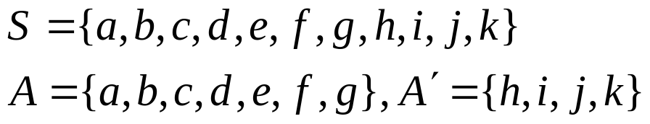
5.6 Partial Orderings
Upper and Lower Bounds 上界和小界
【Definition】Let A be a subset of S in the poset . If
there exists an element a in S such that for all b in A,
then a is called an upper bound of A.
如果a是S的元素使得对所有的元素b∈A，有b≤a,那么a叫做A的一个上界
Similarly for lower bounds.
〖Example 7〗
j
k
the upper bounds of set A：h, i, k, j
the lower bounds of set A：/
the upper bounds of set A’：/
the lower bounds of set A’：f, g, a, b, c, d, e
h
i
g
f
e
b
c
d
a

Slide 107
5.6 Partial Orderings
Least Upper and Greatest Lower Bounds 最小上界与最大下界
【Definition】If a is an upper bound for P which is related to all other upper bounds then it is the least upper bound（最小上界）, denoted by lub(S).
Similarly for the greatest lower bound（最大下界）, glb(S).

Slide 108

5.6 Partial Orderings
〖Example 7〗
Determine the maximal elements, minimal elements, greatest
element, least element of set A, the upper bounds, lower bounds ,
least upper bound , greatest lower bound of set 。
A:
maximal elements: 24,36 minimal elements:2,3
the greatest element: / the least element: /
24
36
12
B₁:
upper bounds: 6,12,24,36 lower bounds: /
The least upper bound: 6 The greatest lower bound:/
6
2
3
B₂:
uper bounds: / lower bounds: 12,6,2,3
The least upper bound: / The greatest lower bound:12

Slide 109


5.6 Partial Orderings
Well-ordered Sets 良序集
【Definition】A poset (A, R) is well-ordered set if every nonempty subset of A has a least element.
（偏序集(A, R)，若A的非空子集均有最小元，则称其为良序集 ）
For example,
Note:
A well-ordered set is a totally ordered set.良序集一定是全序集。

Slide 110
5.6 Partial Orderings
Lattices（格）
【Definition】A poset is called a lattice if every pair of
elements has a lub and a glb. 如果一个偏序集的每对元素都有最小上界和最大下界，就称这个偏序集为格
由定义知，所有的全序都是格，但并非所有的偏序集都是格
〖Example 9〗 Determine whether the following poset is
lattice.
(1)
5
2
4
1
3

Slide 111








5.6 Partial Orderings
(2) ?
lub：the larger of the two elements，
glb：the smaller of the two elements.
Hence, the poset is a lattice.
Note: Every totally ordered set is a lattice.
(3) ?
lub：the least common multiple，
glb：the greatest common divisor
Hence, the poset is a lattice.
(4) ?
, lub： glb：
Hence, the poset is a lattice.

Slide 112

5.6 Partial Orderings
Topological Sorting 拓扑排序
The problem of project schedul:
  Suppose that a project is made up of n different tasks. Some tasks can be completed only after others have been finished. How can an order be found for these tasks? 假设一个项目由20个任务构成。某些任务只能在其他任务结束之后完成。如何找到关于这些任务的顺序？
We impose a total ordering ≤ on a poset compatible with the
partial order if whenever .
如果只要aRb就有a ≤b
(A,R) is a poset. (A,≤) is a total ordering.
If whenever .
The total ordering ≤ is called compatible with the partial ordering R. 则称一个全序≤与偏序R是相容的。

Slide 113

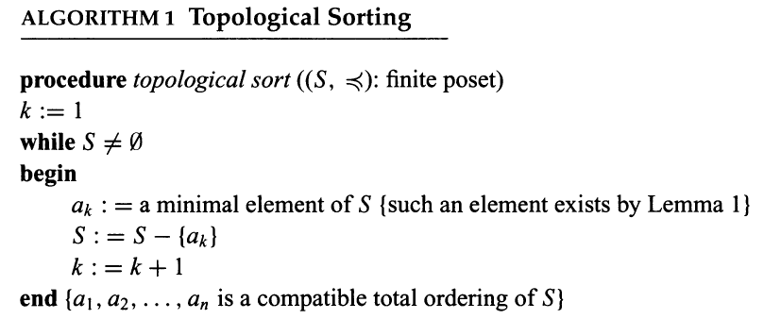
5.6 Partial Orderings
Constructing a compatible total ordering from a partial
ordering is called topological sorting. 从一个偏序构造一个相容的全序叫做拓扑排序

Slide 114
5.6 Partial Orderings
〖Example 7〗A project is broken down into seven tasks. A
partial ordering on tasks is set up by considering task x < task y if
task y can’t be started until task x has been completed.
Find an ordered in which these tasks can be carried out to complete
the project.
G
G
G
D
D
F
D
F
F
B
B
B
E
E
A
E
C
C
G
D
F
G
D
F
The order for the task:
A<C<B<E<F<D<G
E
G
G
F

